Slide 1



PROJECT - I
DECKER
CME 1251 Project Based Learning
BY
2016510035 ENİS YASİR KALAY
2017510027 MUSTAFA ONUR DURKAL
2016510055 RUMEYSA MUSLU

Slide 2

PRESENTATION CONTENT
INTRODUCTION
PROGRESS SUMMARY
Changes in Requirements
Task Sharing and Scheduling
Completed Tasks
Incomplete Tasks:Reasons,Explanations
Additional İmprovements
PROBLEMS ENCOUNTERED
ALGORITHMS AND SOLUTION STRATEGIES
SCREENSHOTS
CONCLUSION
REFERENCES

Slide 3
Introduction
ABOUT OUR PROJECT
The project is doing a card game which has a some rules.(using ourselves algorithm and flowchart and c# language code.
The cards are classical 52-deck.
4 suits which are Heart,Diamond,Spades and Club
Each suit consist of thirteen cards:1,2,3,4,5,6,7,8,9,10,J,Q and K.
J,Q,K are corresponds to 11,12,13,respectively
Every rule has a give a points to the player.
If the cards match up with more than one rule,player gains all corresponding points.

Slide 4
İntroduction
RULES:
CARDS | POİNTS
Consecutive cars of the same suit | 100
The same number of cards | 80
Consecutive cards of the different suits | 20
All cards from the royal family | 10
Non-consecutive cards of the same suit | 5
The total of three cards are 21 | 4
All cards even or odd | 2
All from different suits | 1
Otherwise | 0

Slide 5
Progress Summary
Changes in Requirements;
Our first flowchart seemed so complicated.Primarily we changed a little parts in our algorithm and flowcharts.But not at all.Cause if we did simple algorithm and flowchart,our code will not spesified and functional.Our flowchart maybe still seems complex.
Our first code contain inexplicable variable names.So we changed them to understandable name.
Also first code had a missed commend blocks.We added them.

Slide 6

Progress Summary
Task Sharing and Scheduling;
We separated to parts for sharing.
Rumeysa organize the flowchart on draw.io. Also she controlled and tested to all possibilities in our code. And added commend blocks.
Enis Yasir searched a different codes and try to solve some problems on code such as (upper-lower case sensivity,convert a variable)
Mustafa Onur did a frame to algorithm and code and worked to how can we did shorten code and run a program faster.

Slide 7

Progress Summary
Completed Tasks;
Built up an algorithm to run faster programme.
Overcame to upper-lover case problem.
Done a flowchart schema and framework a code.
Controlled to code and found a mistakes.
Prepare a progress report.

Slide 8

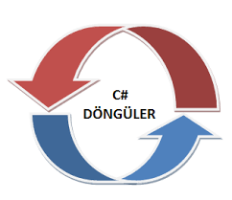
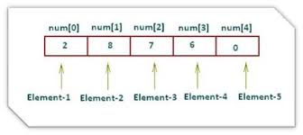
Progress Summary
Incomplete Tasks:Reasons,Explanations
Couldn’t to shorten code.
We have a lot of if block and our solution to list of index to rules
And use this index in a loop.
But we can’t use arrays cause of forbidden…

Slide 9

Progress Summary
Additional Improvements;
Used to commend blocks.
Changed variable names.
We used a parse method in our first code than we changed to convert method.

Slide 10

Problems Encountered
Firstly we have to show point like (x+y+z+t). We couldn’t solve this problem when
our router learned this algorithm.
Another problem is lower-upper case sensivity.
Programme have to input card numbers as a character because player can input
a J,Q and K. And than have to change an integer cause of doing maths operations.
Programme have to contain an error message in some situation
such as same card, exceed limit of number sth…

Slide 11

Algorithm and Solution Strategies
When we analyzed the rules.We thought to seperate 2 parts to rules.
First part : Free rules which have to ask compiler in all possibility.
All cards from royal family.
Total of three cards are 21.
All cards even or odd.
The same number of cards.
Second part : Depended to each other rules.We can analyze together in same
if/else blocks.
Consecutive cards of same suit
Consecutive cards of different suits
Non-consecutive cards of the same suit
All from different suit

Slide 12

Algorithm and Solution Strategies
When we separated rules we could algorithm design easier.
Also didn’t asked double time to compiler so rules.
if the cards same suit.its not necessary to ask different suit (it’s just false)
and we can control in 1 if/else block.
And we separated to first rule which was consecutive cards of the same suits
We thought just same suit and just consecutive.In this way we controlled
1st and 5rd rules together.So code is shorter than before.
Our first part rules were used to end of code for asking all possibilities.

Slide 13
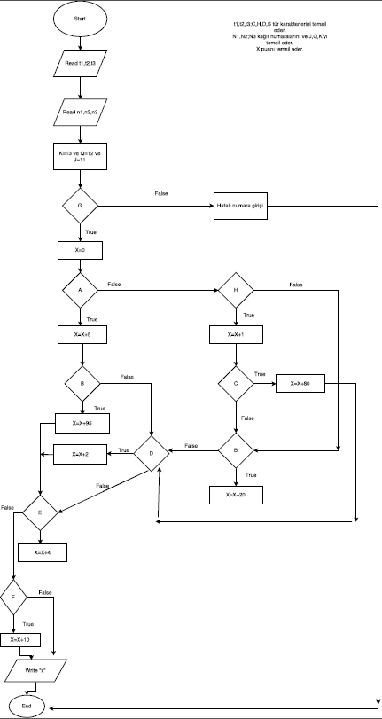
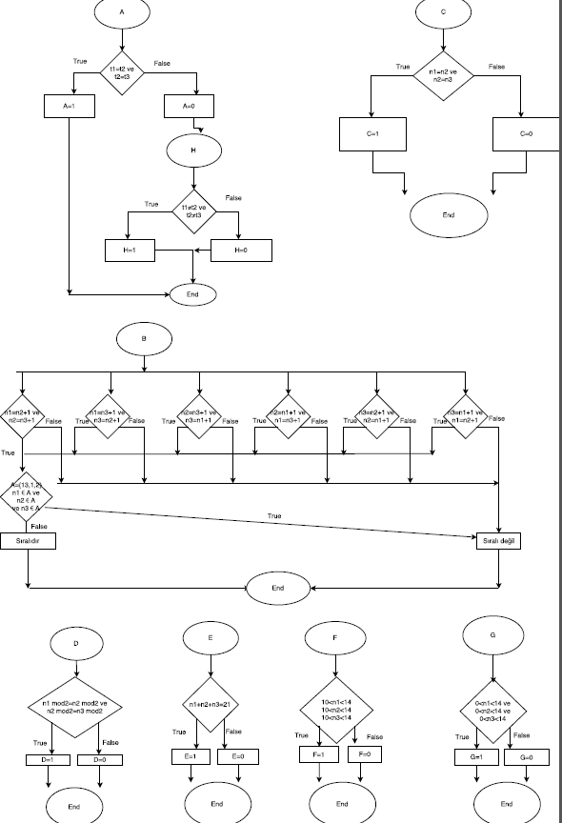
Screenshots

Slide 14
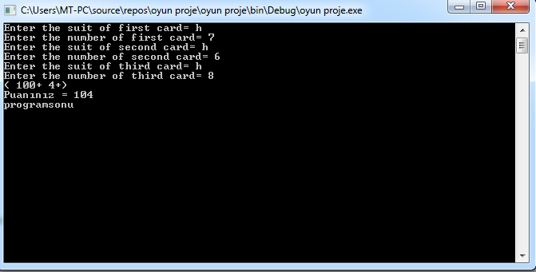
Screenshots

Slide 15
Conclusion
A Decker teaching lot of things. (design algorithm and flowchart, conditions and simple codes)
And this project teaching a group working and sharing task.Its an important for our future,we know that.
Also its too funny for us to first time ordered computer to sth.We are so excited new for new project.

Slide 16
References
https://msdn.microsoft.com/tr-tr
https://www.draw.io/

